Slide 1
The First step Exploratory Data Analysis
Alejandro Ordonez
Assistant Professor - Department of Bioscience
Section for Ecoinformatics & Biodiversity
Center for Biodiversity Dynamics in a Changing World (BIOCHANGE)

Slide 2
Exploratory Data Analysis What we will talk about today
Exploratory Data Analysis - Why?
Summary statistics – Get an overview of your data
Visualisation – A figure is worth 1000 words
Transformations – Making data symmetrical an comparable
Modelling – Establish simple relations between variables
Statistical Test – What are they doing?

Slide 3
Any questions?
Ready to start?

Slide 4
Exploratory Data Analysis: why?
Exploratory Data Analysis (EDA) is the art of looking at your data to rapidly generate many promising leads that you can later explore in more depth.
EDA is the base for statistical analysis of multidimensional data as it:
Provides an overview of the data → is it meaningful?
Establishes if there are errors, outliers, or patterns.
Help to determine the need to transform or recode some variables → are the analytical assumptions meet?
Orient further analyses.

Slide 5
Before Exploratory Data Analysis: get your data in.
Before doing anything in R you need to get your data in the program.
External data is usually a txt or csv file that needs to be “read” using one of two functions.
read.table?
read.csv?
Import
Analyze
Visualize
Clean
Transform
Explore
Model
Reading is not enough, It needs to be stored it as an object!!

Slide 6

Before Exploratory Data Analysis: Clean your data
Import
Analyze
Visualize
There are three interrelated rules which make a dataset suited to be used in R:
Each variable must have its own column.
Each observation must have its own row.
Each value must have its own cell.
Clean
Transform
Explore
Model
Figures: Grolemund and Wickham (2017) R for Data Science

Slide 7
Before Exploratory Data Analysis: Clean your data.
Step 1. Remove
Leading/Trailing spaces.
Comma, dots, hyphens and apostrophes.
(Multiple) spaces for strings.
Step 2. Standardise
To lowercase/UPPERCASE Or
Capitalise.
Put/remove a dots at the end and punctuation.
Change “,” to “;” in the text.
Date formats.
Precision [Nº of decimals]
Step 3. Error checking
Correcting or removing corrupt or inaccurate records.
Eliminate duplicate entries.
Data type consistency within a column.
Figures: Grolemund and Wickham (2017) R for Data Science

Slide 8
Exploratory Data Analysis What to do before you start?
The two crucial questions you will always ask:
What type of variation occurs within my variables?
Variation is a description of how a random variable is dispersed, or spread out.
What type of covariation occurs between my variables?
Covariation is a description of the relationship between two random variables
Import
Analyze
Visualize
Clean
Transform
Explore
Model

Slide 9
Exploratory Data Analysis: tools
EDA uses four main tools to answer the two key questions:
Descriptive statistics: Quantitative descriptions or summaries of the features from a collection of information.
Visualisation: The graphical representation of information and data to see and understand trends, outliers, and patterns.
Transformation: process of changing the format, structure, or values of data.
Modelling: simple low-dimensional summaries of a dataset, and trends assessments.

Slide 10
Exploratory Data Analysis: tools
Descriptive
statistics
Visualisation
Transformation
Modelling
Figures: Grolemund and Wickham (2017) R for Data Science

Slide 11
Exploratory Data Analysis: tools
Descriptive
statistics
Visualisation
Transformation
Modelling
Figures: Grolemund and Wickham (2017) R for Data Science

Slide 12
EDA – Descriptive statistics
Summaries provide a good way to:
Look at patterns and the quality of your data.
Communicate the largest amount of information as simply as possible.
All your observations regarding a single variable can be described in terms of:
Central tendency (mean, median, mode).
Dispersion (variance, standard deviation, coefficient of variation).
Shape of the distribution (skewness, kurtosis).
Statistical dependence (correlation coefficients).

Slide 13

EDA – Descriptive statistics
Central tendency
Characterises the central point of the observations
Mean
Median
Mode
$σ^{2}=$ Variance
$σ=$ Standard Deviation
$\frac{σ}{\sqrt{n}}=$Standard Error
$$σ^{2}=\sqrt{\frac{\sum{{\left(x_{i}−μ\right)}^{2}}}{N}}$$
Dispersion
Characterises the variability of the observations

Slide 14

EDA – Descriptive statistics
Shape
Characterize the deviation from a normal (symmetrical) distribution
Skewness
$${Sk}_{1}=\frac{μ−Mo}{σ^{2}}$$
$${Sk}_{2}=\frac{3\left(μ−Md\right)}{σ^{2}}$$
Skewness direction given by the sign
μ < Md or Mo
μ > Md or Mo

Slide 15
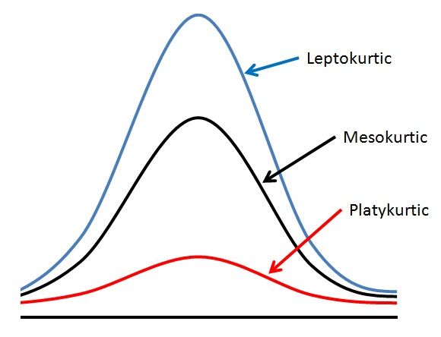


EDA – Descriptive statistics
Shape
Help to identify outlier problems.
$$g_{2}=\frac{m_{4}}{m_{4}}−3$$
$=\frac{\frac{1}{n\sum_{i=1}^{n}{{\left(x_{i}−\overline{x}\right)}^{4}}}}{{\left[n\sum_{i=1}^{n}{{\left(x_{i}−\overline{x}\right)}^{4}}\right]}^{2}}−3$
Kurtosis
Larger kurtosis = serious outlier problem

Slide 16
Exploratory Data Analysis: tools
Descriptive
statistics
Visualisation
Transformation
Modelling
Figures: Grolemund and Wickham (2017) R for Data Science

Slide 17
EDA – Visualization
The Three main functions of graphical displays in data analysis:
Explore: Checking data for unusual values, making sure the data meet the assumptions of the chosen analysis and occasionally deciding what analysis (or model) to use.
Analyse: Checking assumptions and ensuring that the chosen model is a realistic fit to the data.
Present: Summarizing numerical information and graphical displays for specific statistical purposes.

Slide 18
visualization: Basic Types
Box-plots
graphical representation of different descriptive statistics
Histograms
graphical representation of a frequency (or density) of the observations.
Dotplots
Each observation is represented by a single dot or symbol.

Slide 19
visualization: BOX-PLOTs
Q3 + (1.5XIQR)
3rd Quantile
median
1st Quantile
Q1 – (1.5XIQR)
How would identify and outlier using a Boxplot

Slide 20
visualization: Histogram
Which is the shape of the distribution?
This is the most important point we want to know about our observations, and therefore about the population from which our data came
Why?: Most of “common” the statistical tests assume that the variables being analysed have normal distributions

Slide 21
R Fundamentals: Normality test
Normality of a series of observations can be tested by using the Shapiro–Wilk test
shapiro.test()
If the test is Non significant you have normality!
Normality of a series of observations can be evaluated by using quantile–quantile plots
qqnorm() and qqline()
Departures from normality show up as S-shapes or banana shapes
> # Normality Tests
> ### test using a Normal distribution
> shapiro.test(rnorm(100, mean = 5, sd = 3))
Shapiro-Wilk normality test
data: rnorm(100, mean = 5, sd = 3)
W = 0.98122, p-value = 0.1654
> ### test using a Poisson distribution
> shapiro.test(rpois(1000, lambda=5))
Shapiro-Wilk normality test
data: rpois(1000, lambda = 5)
W = 0.97227, p-value = 6.871e-13
Is this normal?
qqnorm(x.1)
qqline(x.1,
lty=2,
lwd=2,
col="red")

Slide 22
visualization: Bar plots

Slide 23
visualization: DOTPLOT
One variable
Dotplot
Two variables
Scatterplot
Multiple variables
Scatterplot
This is the ”position” in the original table

Slide 24
Exploratory Data Analysis: tools
Descriptive
statistics
Visualisation
Transformation
Modelling
Figures: Grolemund and Wickham (2017) R for Data Science

Slide 25
EDA – Transformations
Data transformation: Converting data from one format or structure into another format or structure.
Aims of data transformations are:
Make the data and the model error terms closer to a normal distribution.
Reduce any relationship between the mean and the variance.
Reduce the influence of outliers, especially when they are at one end of a distribution.
Make effects that are multiplicative on the raw scale additive on a transformed scale.

Slide 26
EDA – Transformations
Data transformation: Converting data from one format or structure into another format or structure.
Normalizing
Make the distribution of the data symmetrical
Standardising
Put all variable in units of variation
[mean of 0 and a standard deviation of 1]

Slide 27
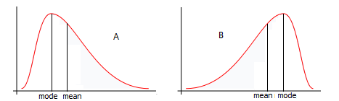
EDA – Normalizing
Right skewed
Left skewed
Normalizing these distributions is useful in statistical modelling because:
Makes data and errors Normal.
Reduces relations between Mean and variance.
Reduces the influence of outliers.
Makes multiplicative effects on a raw scale linear on the transformed scale.

Slide 28
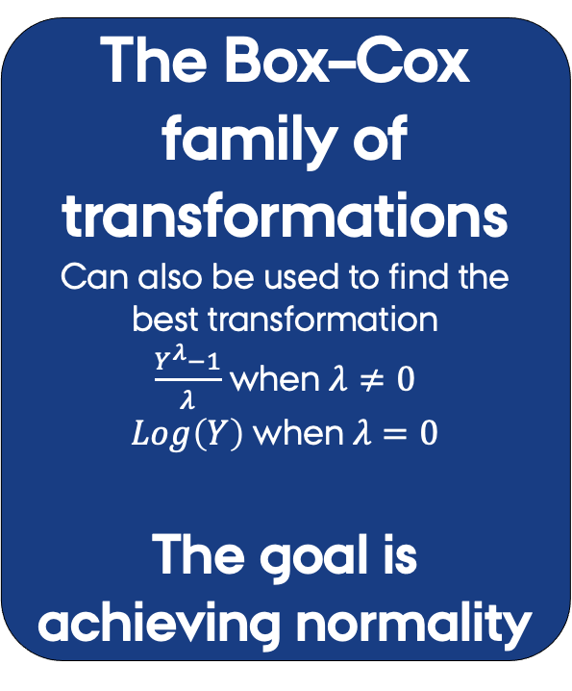
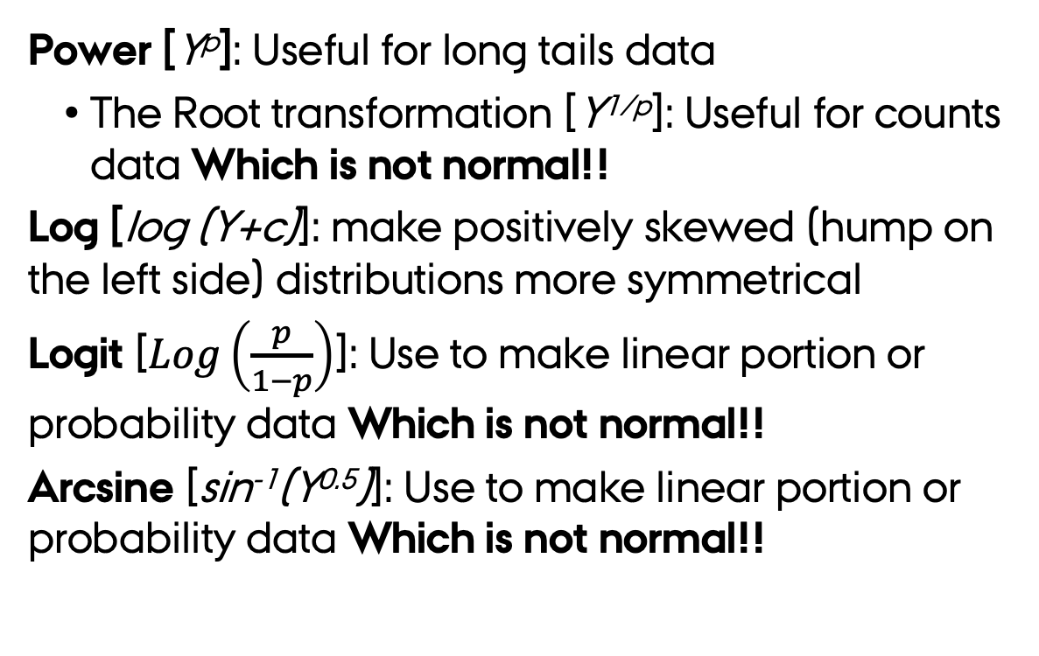
EDA – Normalizing
Power [Y^{p}]: Useful for long tails data
The Root transformation [Y^{1/p}]: Useful for counts data Which is not normal!!
Log [log (Y+c)]: make positively skewed (hump on the left side) distributions more symmetrical
Logit [$Log\left(\frac{p}{1−p}\right)$]: Use to make linear portion or probability data Which is not normal!!
Arcsine [sin⁻¹(Y^{0.5})]: Use to make linear portion or probability data Which is not normal!!
The Box–Cox family of transformations
Can also be used to find the best transformation
$\frac{Y^{λ}−1}{λ}$ when $λ≠0$
$Log\left(Y\right)$ when $λ=0$
The goal is achieving normality

Slide 29
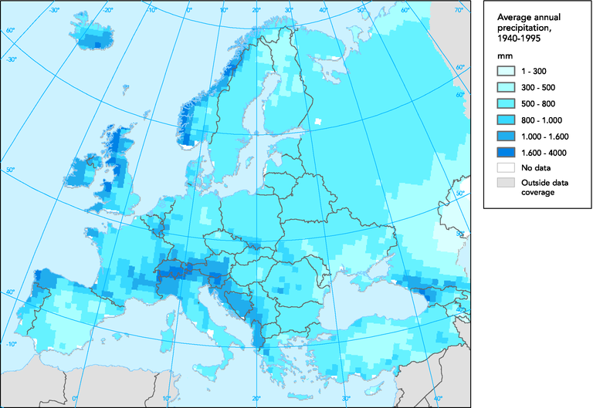
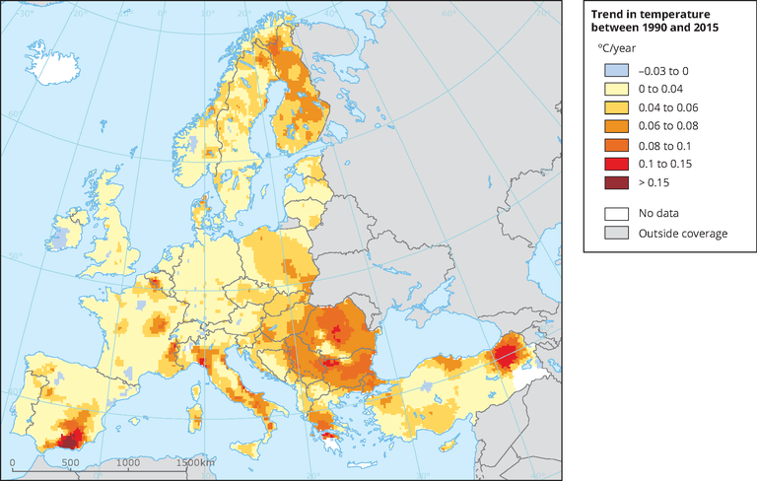
EDA – standardisations
Temperature is measured in C
Precipitation is measured in mm
Stabilization allows contrasting the effects of variables measured in different units in modelling frameworks

Slide 30
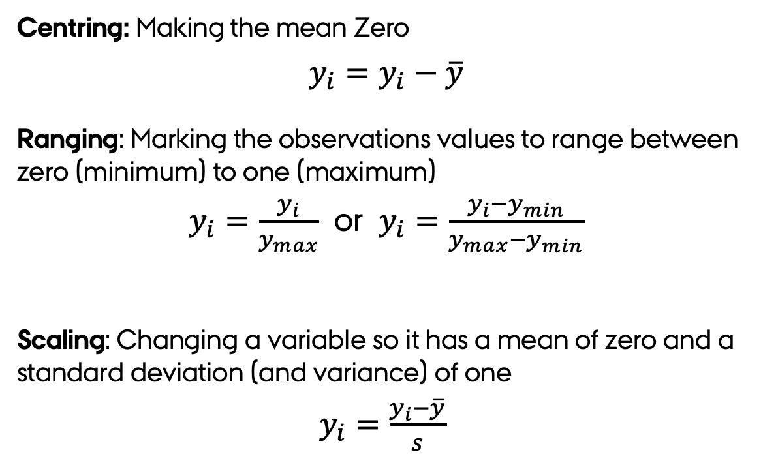
EDA – standardisations
Different standardisations are possible:
Centring: Making the mean Zero
$y_{i}=y_{i}−\overline{y}$
Ranging: Marking the observations values to range between zero (minimum) to one (maximum)
$y_{i}=\frac{y_{i}}{y_{max}}$ or $y_{i}=\frac{y_{i}−y_{min}}{y_{max}−y_{min}}$
Scaling: Changing a variable so it has a mean of zero and a standard deviation (and variance) of one
$y_{i}=\frac{y_{i}−\overline{y}}{s}$
Centring and Ranging
useful as standardisations of abundance data before multivariate analyses
Scaling
useful to convert all the variables to a similar scale

Slide 31
EDA – standardisations
Centring
Ranging
Scaling

Slide 32
Exploratory Data Analysis: tools
Descriptive
statistics
Visualisation
Transformation
Modelling
Figures: Grolemund and Wickham (2017) R for Data Science

Slide 33
EDA – Modelling
Modelling: Converting data from one format or structure into another format or structure.
Aims of Modelling before doing any analyses are:
Assess regressions assumptions (more on this next week).
Determine (in)dependence between variables → correlations
Establish additive effects if variables are dependent → linearity

Slide 34
Modelling – Correlations
Correlation coefficients is a statistical measure which determines the ‘strength’ of the covariance or association of two continuous variables (Y₁ and Y₂).
Correlation coefficients assume monotonic relations → always changes in the same direction
Correlation coefficients bounded between -1 and 1
y₂
Monotonically
Increasing
y₂
Monotonically
Decreasing
y₁
y₁
y₂
Non-monotonic
y₁

Slide 35
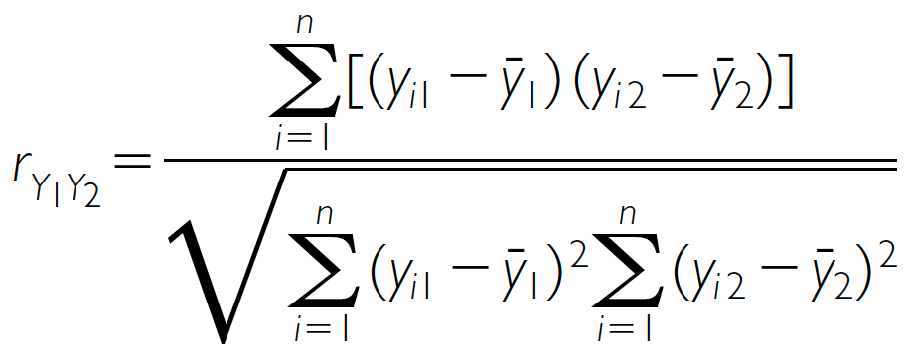
Modelling – Correlation
Parametric indices
Non-Parametric indices
Pearson correlation (r)
Spearman’s rank correlation (r_{S})
n is the number of pairs of measurements
d_{i} is the difference of the i^{th} pair of rankings
Other assumptions: normality of variables and linearity
Kendall’s rank correlation(𝜏_{A})
Correlation DOES NOT mean directionality or causality.

Slide 36
Modelling – Significance
Statistically significant means that if the Null Hypothesis (H₀) is false.
One tail test
Two tail test
H₀ Acceptance area
P=0.95
P=0.95
P=0.05
P=0.05

Slide 37
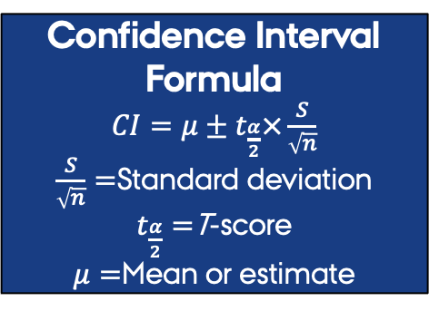
Modelling – Significance & Correlation
H₀ = Correlation estimate 95% CI includes 0
Two tail test
Estimate 95% confidence interval
The true value has a 95% change of being in this range
Confidence Interval Formula
$CI=μ±t_{\frac{α}{2}}×\frac{S}{\sqrt{n}}$
$\frac{S}{\sqrt{n}}=$Standard deviation
$t_{\frac{α}{2}}=$T-score
$μ=$Mean or estimate
Min
Lower
CI
Correlation
Mean
Upper
CI
Max
P=0.05

Slide 38
So far so good?
Any questions?
Ready to finish?

Slide 39
Summary
Exploratory Data Analysis (EDA) is the art of looking at your data
EDA is also the base for statistical analysis of multidimensional data
Before you stat you need to import and clean your data
The two crucial questions you will always ask:
What type of variation occurs within my variables?
What type of covariation occurs between my variables?

Slide 40
Summary
EDA uses four main tools:
Descriptive statistics: Quantitative descriptions or summaries of the features from a collection of information.
Visualisation: The graphical representation of information and data to see and understand trends, outliers, and patterns.
Transformation: process of changing the format, structure, or values of data
Modelling: simple low-dimensional summaries of a dataset, and trends assessments.

Slide 42
Variation - Exercises
Explore the distribution of each of the x, y, and z variables in diamonds.
What do you learn? Think about a diamond and how you might decide which dimension is the length, width, and depth.
Explore the distribution of price.
Do you discover anything unusual or surprising?
How many diamonds are 0.99 carat? How many are 1 carat?
What do you think is the cause of the difference?
Compare and contrast coord_cartesian() vs. xlim() or ylim() when zooming in on a histogram.
What happens if you leave binwidth unset?
What happens if you try and zoom so only half a bar shows?

Slide 43
Unusual values - Exercises
What happens to missing values in a histogram?
What happens to missing values in a bar chart?
Why is there a difference in how missing values are handled in histograms and bar charts?
What does na.rm = TRUE do in mean() and sum()?
Recreate the frequency plot of scheduled_dep_time colored by whether the flight was cancelled or not. Also facet by the cancelled variable.
Experiment with different values of the scales variable in the faceting function to mitigate the effect of more non-cancelled flights than cancelled flights.

Slide 44
Covariation – Exercises 1
Based on EDA, what variable in the diamonds dataset appears to be most important for predicting the price of a diamond?
How is that variable correlated with cut?
Why does the combination of those two relationships lead to lower quality diamonds being more expensive?
Instead of exchanging the x and y variables, add coord_flip() as a new layer to the vertical boxplot to create a horizontal one.
How does this compare to exchanging the variables?
One problem with boxplots is that they were developed in an era of much smaller datasets and tend to display a prohibitively large number of “outlying values”. One approach to remedy this problem is the letter value plot. Install the lvplot package and try using geom_lv() to display the distribution of price vs. cut.
What do you learn? How do you interpret the plots?

Slide 45
Covariation – Exercises 2
Create a visualization of diamond prices vs. a categorical variable from the diamonds dataset using geom_violin(), then a faceted geom_histogram(), then a colored geom_freqpoly(), and then a colored geom_density().
Compare and contrast the four plots.
What are the pros and cons of each method of visualizing the distribution of a numerical variable based on the levels of a categorical variable?
If you have a small dataset, it’s sometimes useful to use geom_jitter() to avoid overplotting to more easily see the relationship between a continuous and categorical variable.
The ggbeeswarm package provides a number of methods similar to geom_jitter(). List them and briefly describe what each one does.

Slide 46
Covariation – Exercises 3
How could you rescale the count dataset above to more clearly show the distribution of cut within color, or color within cut?
What different data insights do you get with a segmented bar chart if color is mapped to the x aesthetic and cut is mapped to the fill aesthetic?
Calculate the counts that fall into each of the segments.
Use geom_tile() together with dplyr to explore how average flight departure delays vary by destination and month of year.
What makes the plot difficult to read?
How could you improve it?

Slide 47
Covariation – Exercises 4
Instead of summarizing the conditional distribution with a boxplot, you could use a frequency polygon. What do you need to consider when using cut_width() vs. cut_number()? How does that impact a visualization of the 2d distribution of carat and price?
Visualize the distribution of carat, partitioned by price.
How does the price distribution of very large diamonds compare to small diamonds? Is it as you expect, or does it surprise you?
Combine two of the techniques you’ve learned to visualize the combined distribution of cut, carat, and price.

Slide 48
Covariation – Exercises 5
Two dimensional plots reveal outliers that are not visible in one dimensional plots. For example, some points in the following plot have an unusual combination of x and y values, which makes the points outliers even though their x and y values appear normal when examined separately. Why is a scatterplot a better display than a binned plot for this case?
Instead of creating boxes of equal width with cut_width(), we could create boxes that contain roughly equal number of points with cut_number(). What are the advantages and disadvantages of this approach?
diamonds |>
filter(x >= 4) |>
ggplot(aes(x = x, y = y)) +
geom_point() +
coord_cartesian(xlim = c(4, 11), ylim = c(4, 11))
ggplot(smaller, aes(x = carat, y = price)) +
geom_boxplot(aes(group = cut_number(carat, 20)))

